Slide 1
RunMo
Run Motion Capture and Analysis on the Cloud and on Edge
James Wall, Tosin Akinpelu, and Mumin Khan

Slide 2


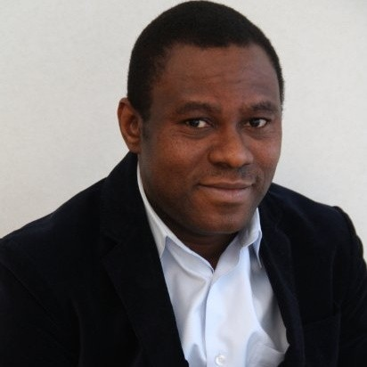
THE TEAM
James Wall
Mumin Khan
Tosin Akinpelu

Slide 3
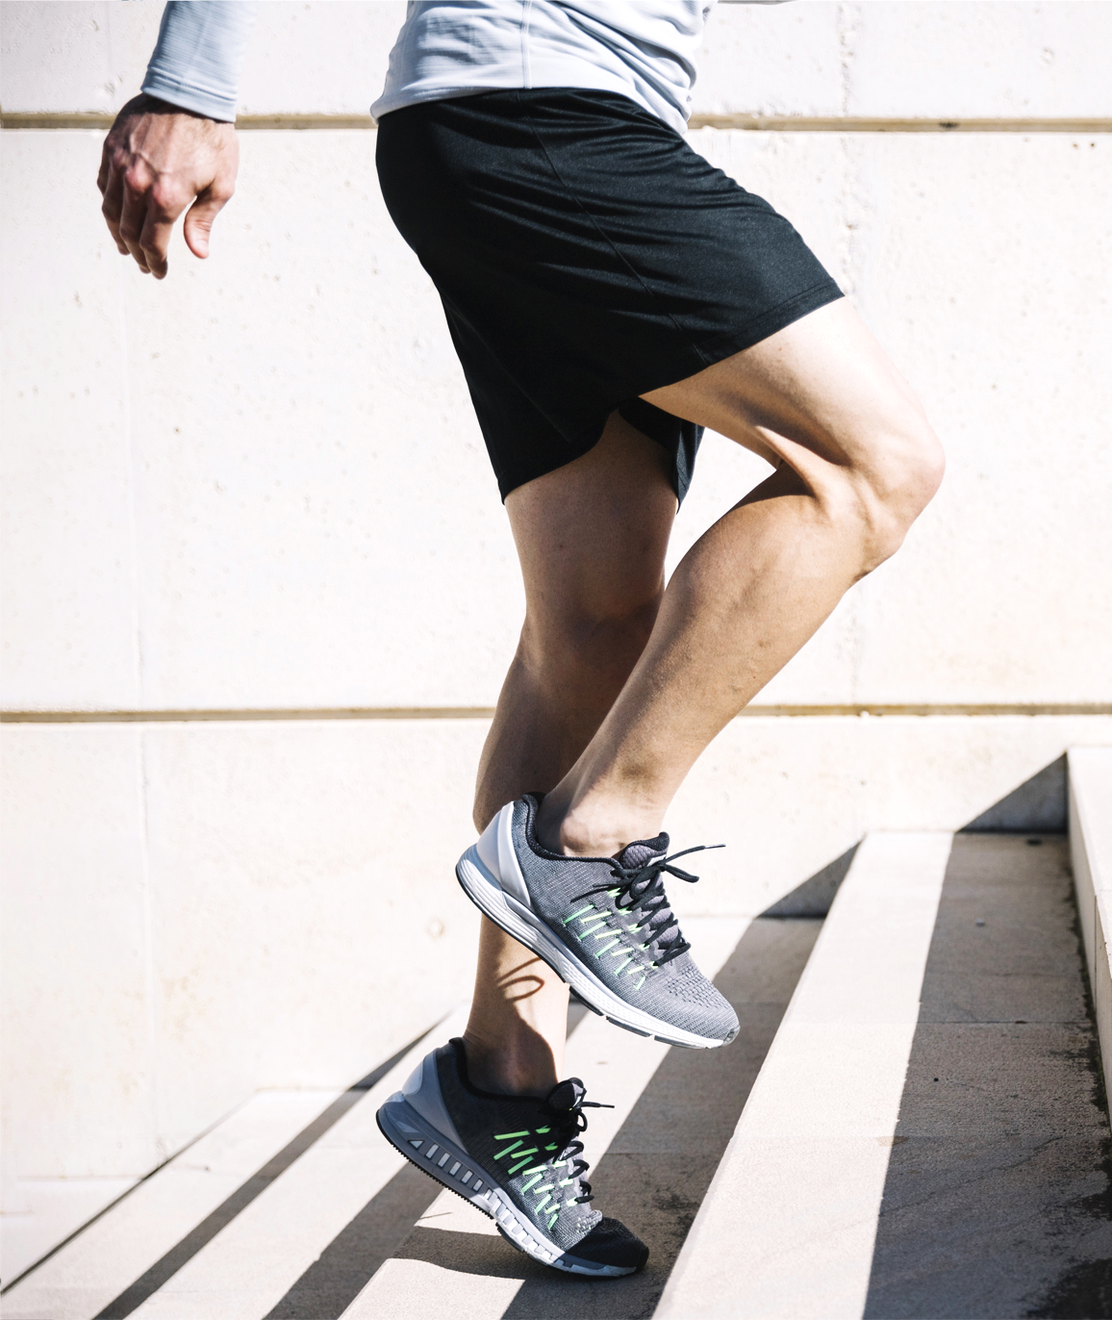
INTRODUCTION
Running is one of the world’s most democratized sport
Yet access to tailored mentorship is often expensive and exclusive
Poor running posture can lead to:
Plantar fasciitis
ITB syndrome
Runner’s knee
Shin splints
Achilles tendonitis
More serious muscle and tendon tears

Slide 4
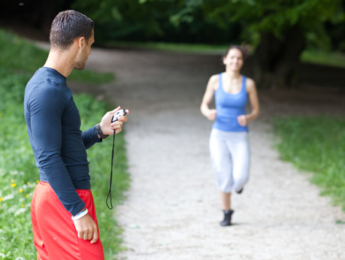
EXISTING SOLUTIONS
Interactive workout apps
Human coaching
Physical posture correctors
Sensor based correctors

Slide 5
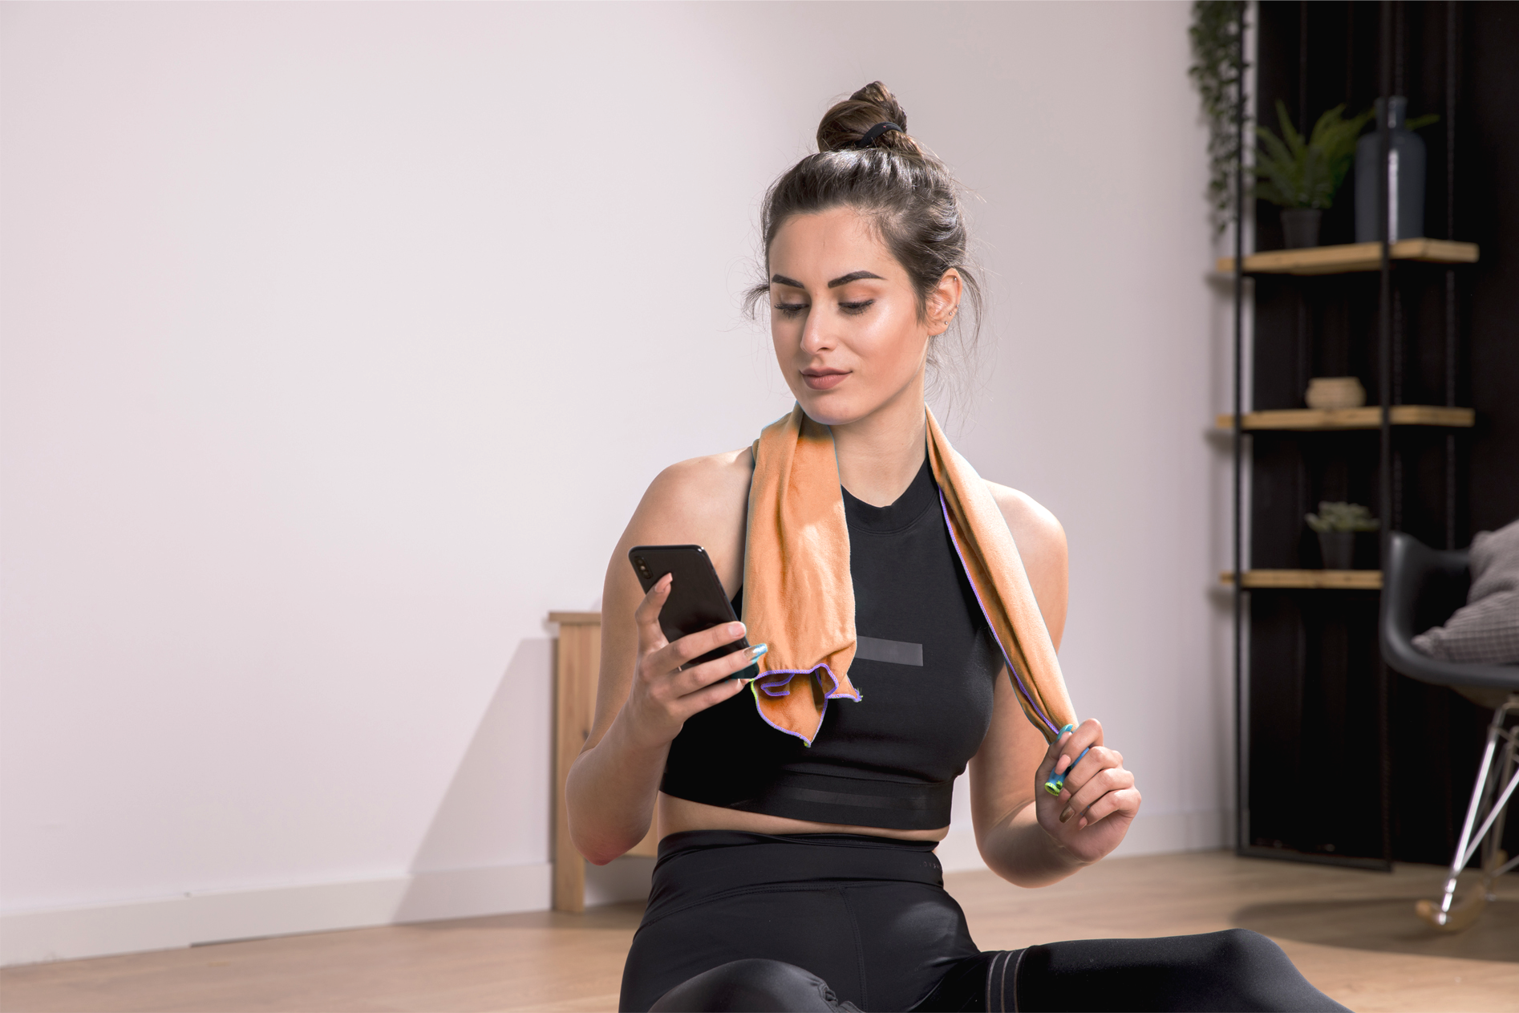
CAN WE DO BETTER?
RunMo was built to bridge the gap between general
AI workout and tailored running solutions

Slide 6
HIGH LEVEL OVERVIEW
Record User on Edge
01
Persist Data on Cloud
02
Learn User’s Features on Cloud
03
Send Results to Edge
04
Users can use any camera device with internet to stream themselves running
Data should be collected and stored off-device for future re-analysis
RunMo should provide near real-time recommendations
Users get to quickly consume the results of their analysis

Slide 7
Begin James

Slide 8
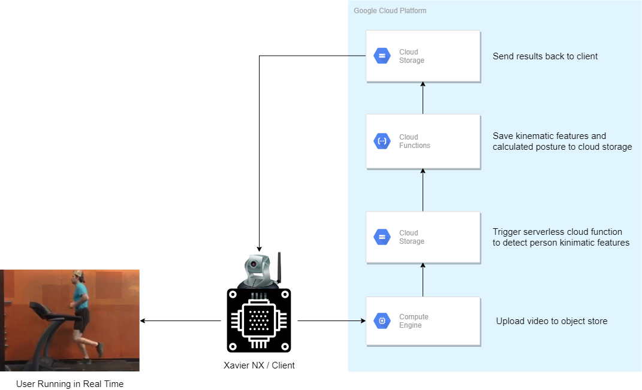
ARCHITECTURE

Slide 9
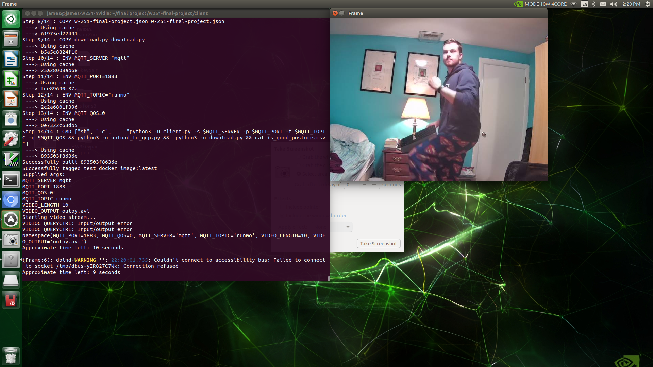
CAPTURE ON NX XAVIER

Slide 10
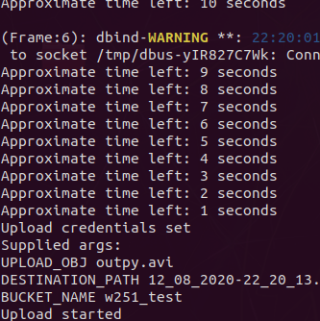
CLOUD INTERFACE

Slide 11
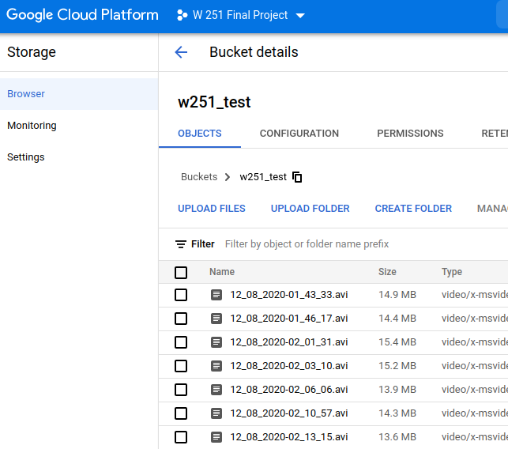
DATA PERSISTENCE

Slide 12
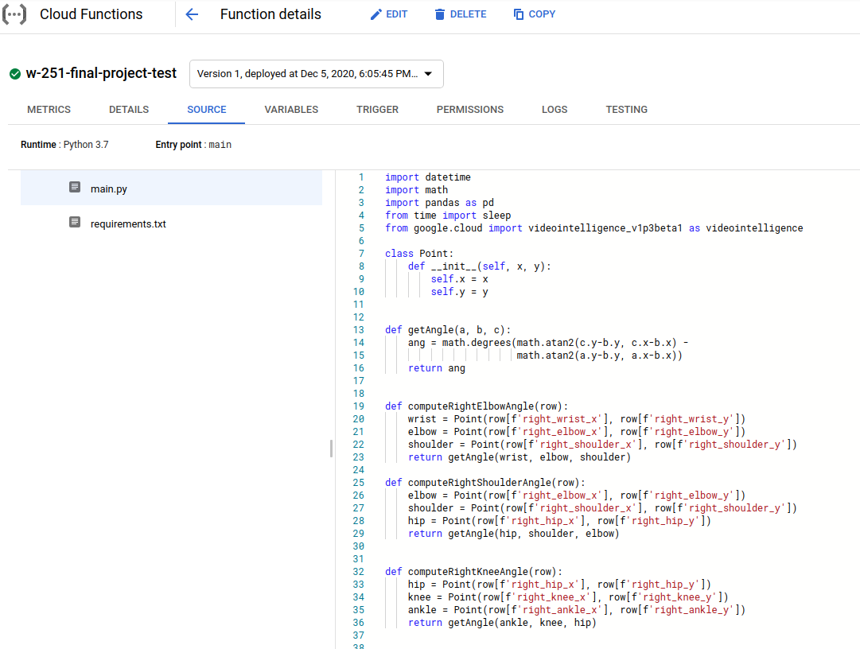
PROCESSING MODEL FEATURES

Slide 13
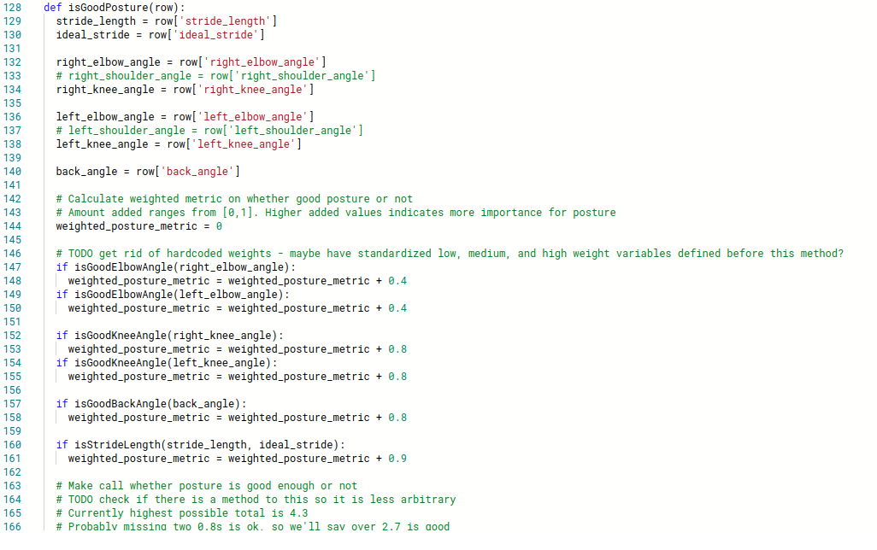
POSTURE CALCULATION

Slide 14
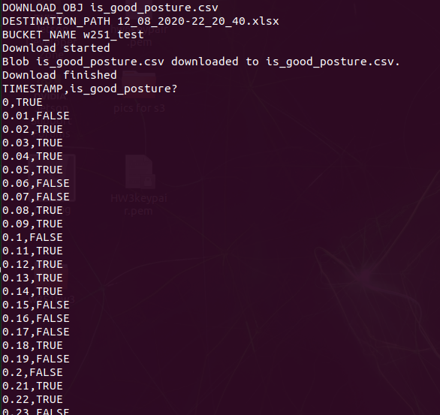
RESULT REPORTING
Nvidia Xavier NX receiving recommendation from RunMo pipeline

Slide 15
Begin Tosin

Slide 16
LEARNINGS
No need to reinvent the wheel under time crunch; explored available MLaaS cloud solutions:
Amazon, IBM, Microsoft & Google offer video analytics REST APIs (some in beta versions)
These platforms leverage advances in Deep Learning under the hood
We chose Google Video Intelligence for their Pose Detection service which is relevant to our project
Ideas are great but execution is ‘everything’

Slide 17
CHALLENGES
THE APP DESIGN
MQTT protocol (a core feature of our project workflow) does not support video robustly
API did not work when all points were not present
Robust error handling for when ankle, etc. were missing from frame
MURPHY’S LAW
NX breaks just in time, house moves, covid-19

Slide 18
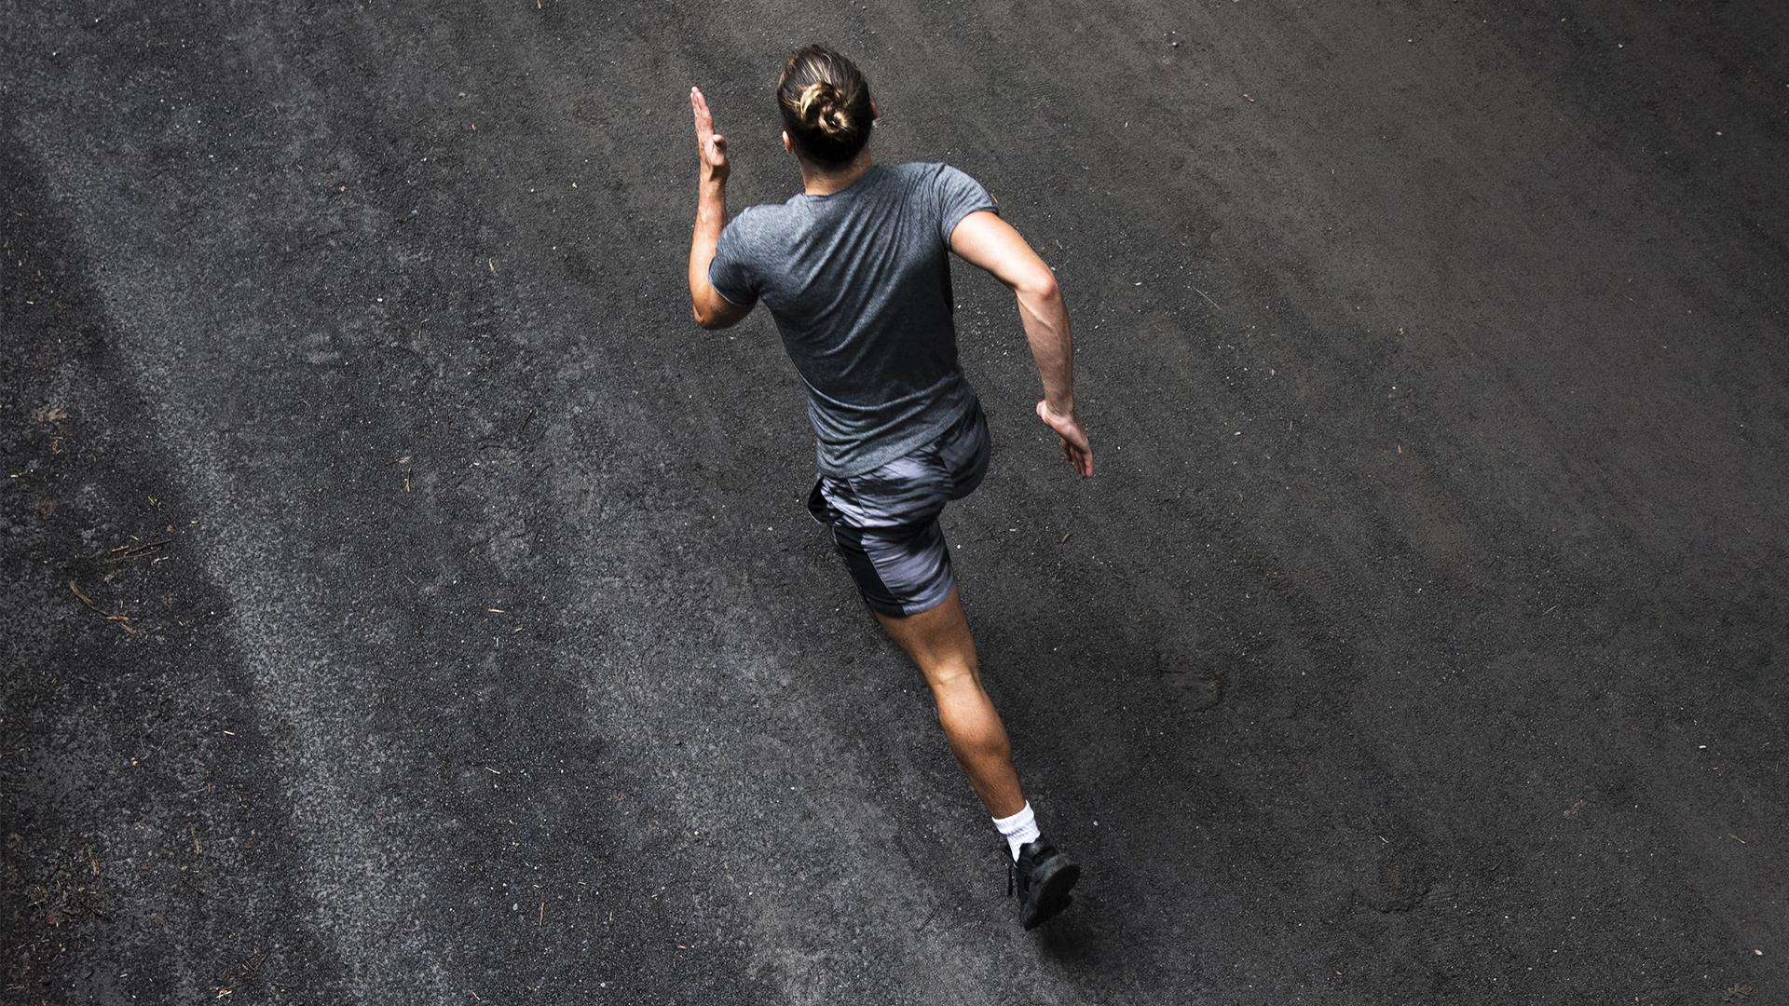
Conclusion
RunMo makes live running advisory service accessible to runners with minimal hardware investment
The solution can be extended to wider application areas leveraging Deep Learning in the Cloud.

Slide 19
Thank you!
Questions, Comments, or Concerns?

